Slide 1
Death Valley
National Park, one of the hottest places on Earth

Slide 2
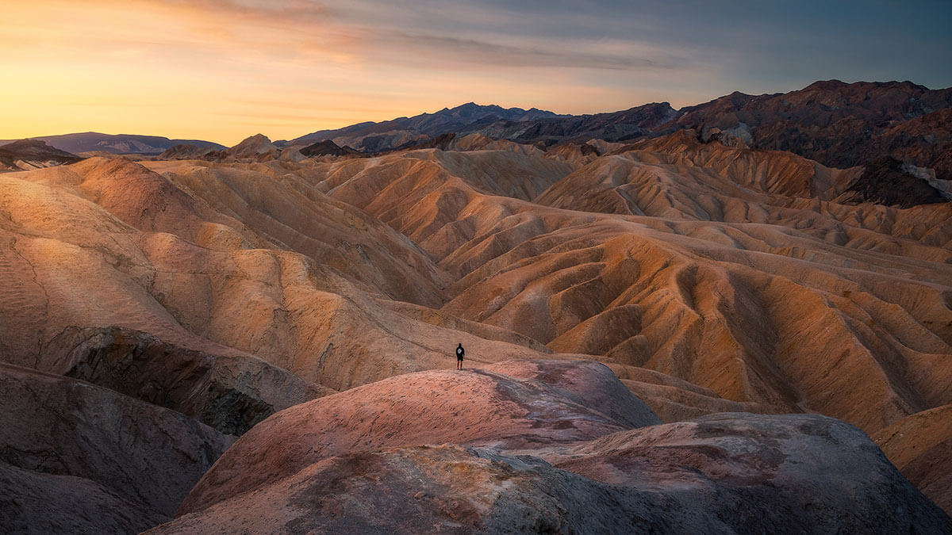
Location
Death Valley National Park is located in eastern California, near the border with Nevada. It is part of the Mojave Desert and is the largest national park in the contiguous United States. The park covers 3.4 million acres of desert and mountains, making it a vast and diverse landscape.

Slide 3
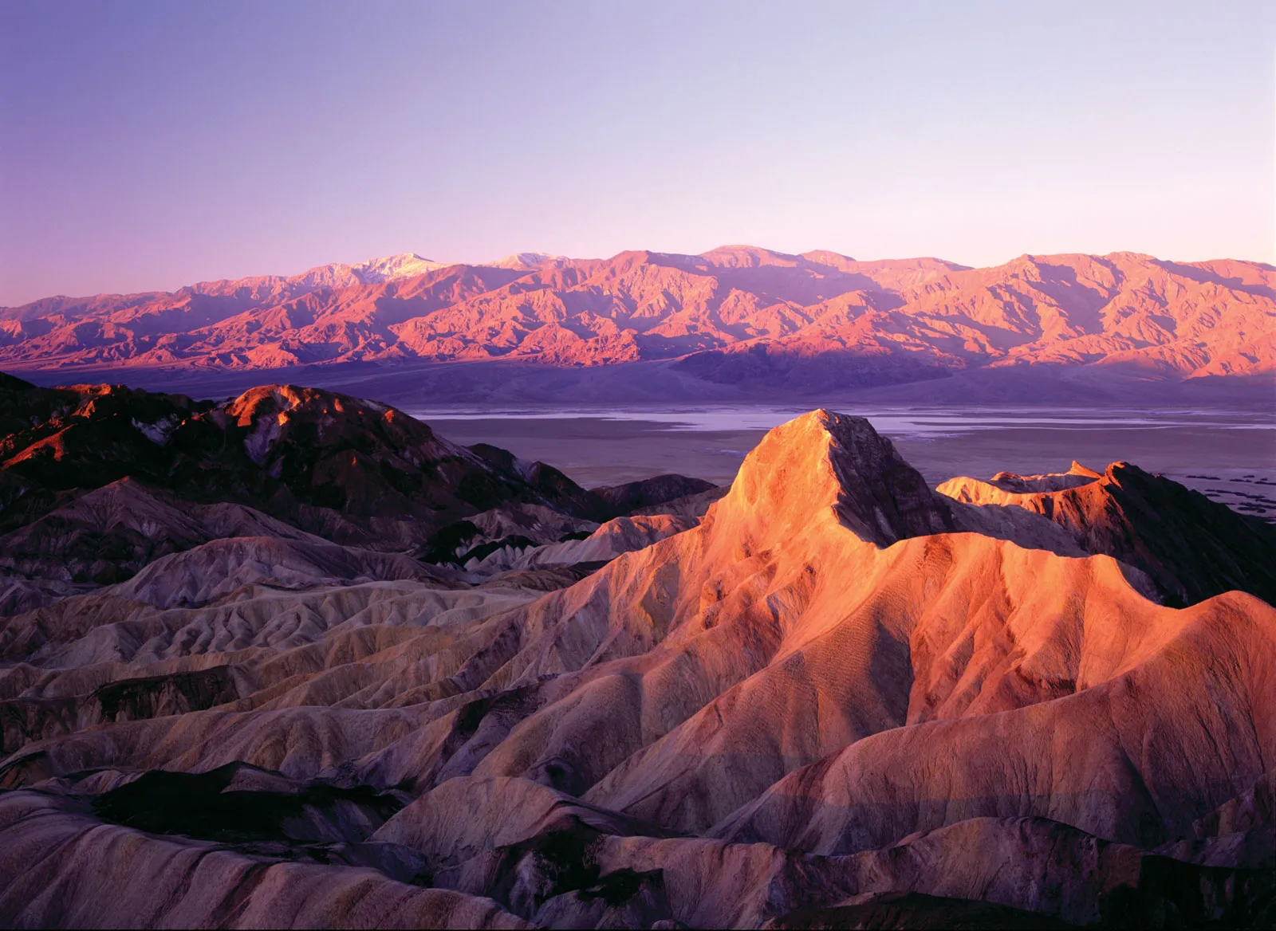
Fun Facts about Death Valley
Hottest Place on Earth: Death Valley holds the record for the highest temperature ever recorded on Earth, which was 57°C in 1913.
Lowest Point in North America: Badwater Basin is 86 meters below sea level, making it the lowest point in North America.
Largest National Park: It is the largest national park in the contiguous United States, covering 3.4million acres.
Extreme Dryness: It receives less than 2 inches (5 cm) of rain per year on average.

Slide 4
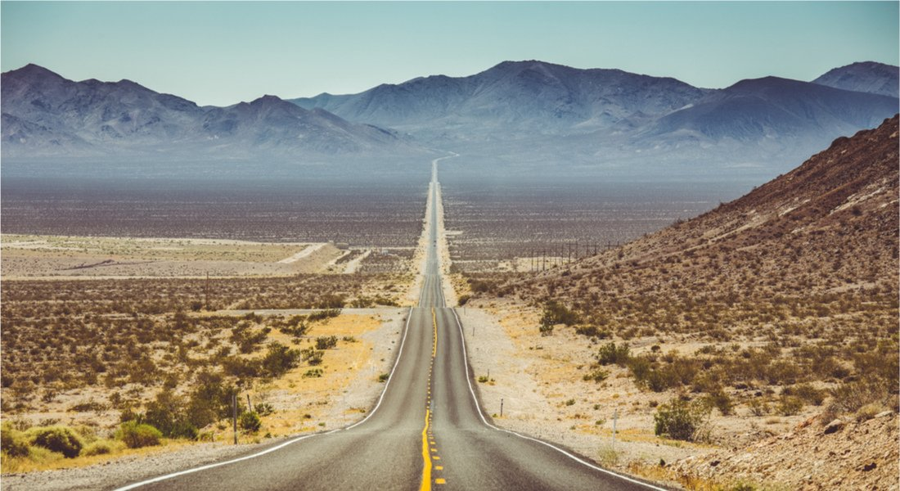
Origin of the Name
Death Valley was named by pioneers in 1849 who were lost in the area during the California Gold Rush. They faced extreme heat, lack of water, and difficult terrain. Although only one person is believed to have died, the experience was so difficult that they named it "Death Valley" as a reminder of their ordeal.

Slide 5
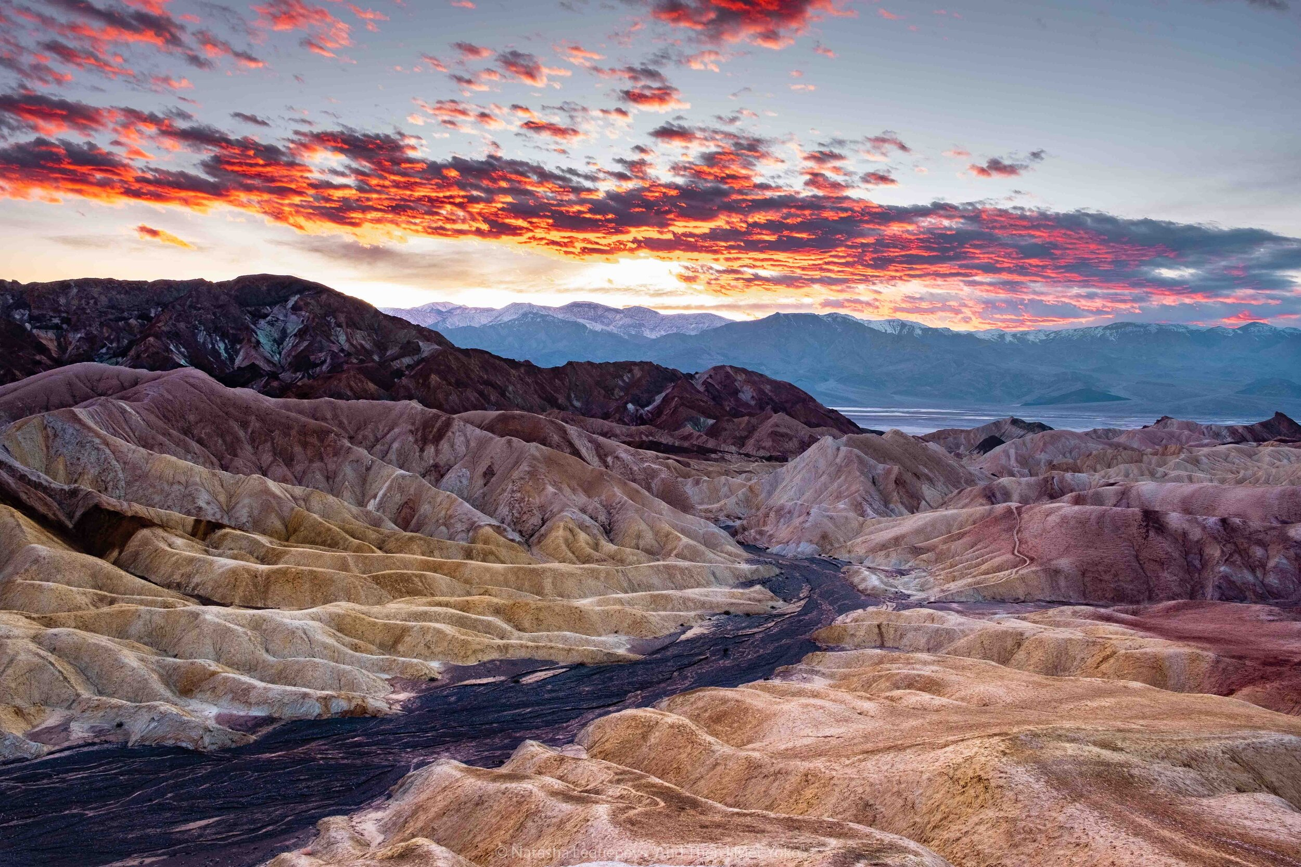
Unique Landscapes
Death Valley has amazing and different landscapes. There are huge salt flats in Badwater Basin that look like a white desert. There are also big sand dunes at Mesquite Flat Dunes where you can hike. The colorful rocks at Artist's Palette are really pretty. There are also canyons like Golden Canyon where you can hike. Devil’s Golf Course has strange and cool rock formations.

Slide 6
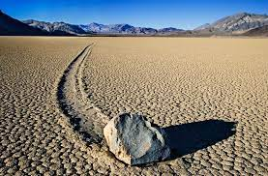
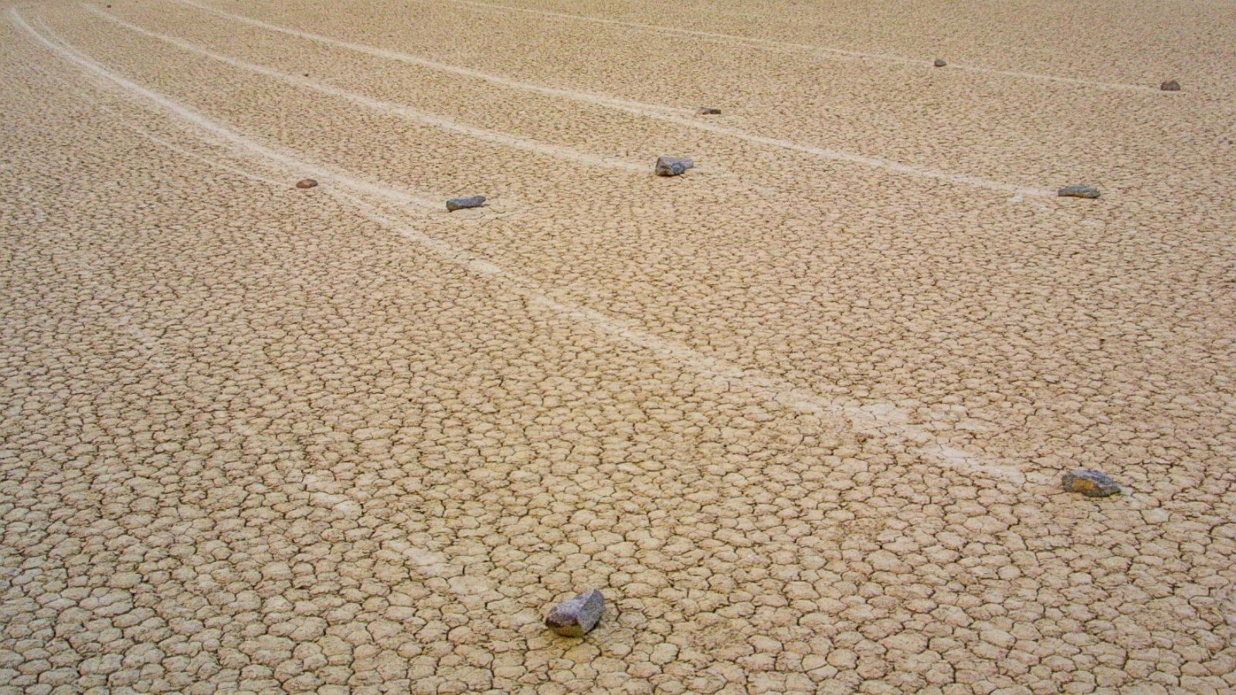
The Mystery of the Moving Rocks
There is a place in Death Valley called Playa Racetrack where the rocks seem to move on their own. These stones, called "sailing stones" leave long trails at the bottom of a dried-up lake. Scientists believe that the combination of wind, ice and thin layers of water causes rocks to slide on the ground. This unique and unusual phenomenon attracts many visitors.

Slide 7
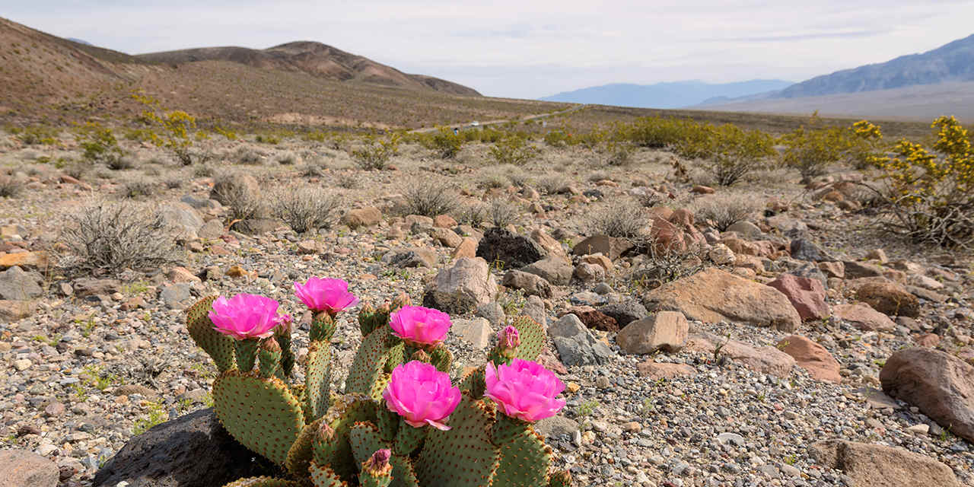
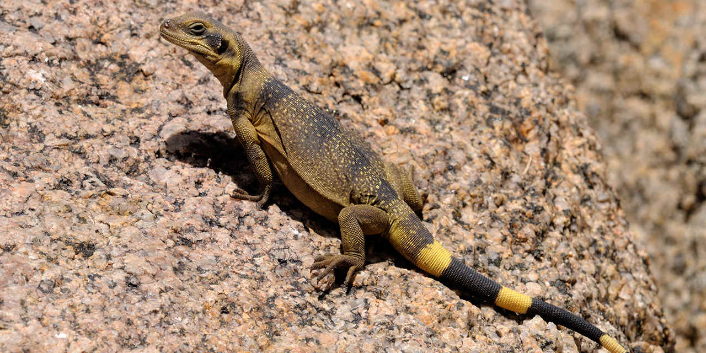
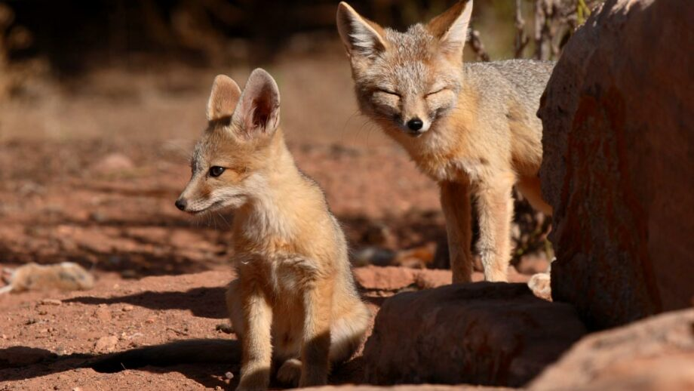
Animals and Plants
Even though it’s really hot and dry, many animals live in Death Valley. You can find coyotes, lizards, bighorn sheep, and even the endangered Death Valley pupfish. Plants like Joshua trees, creosote bushes, and desert holly grow here. They have special ways to survive in the heat and dryness.

Slide 8

Thanks for attention)
Prepared: Sidorov D. S.

